Slide 1


System-versioned tables for MySQL (SQL:2011 temporal tables)
Vinicius Grippa
Lead Database Engineer @ Readyset

Slide 2
System-versioned tables for MySQL
https://bugs.mysql.com/bug.php?id=120432
System-versioned tables are the SQL:2011 answer to "what did this row look like last Tuesday." Oracle, SQL Server, DB2, and MariaDB ship them today.
Solution today: https://dbtrail.com/

Slide 3
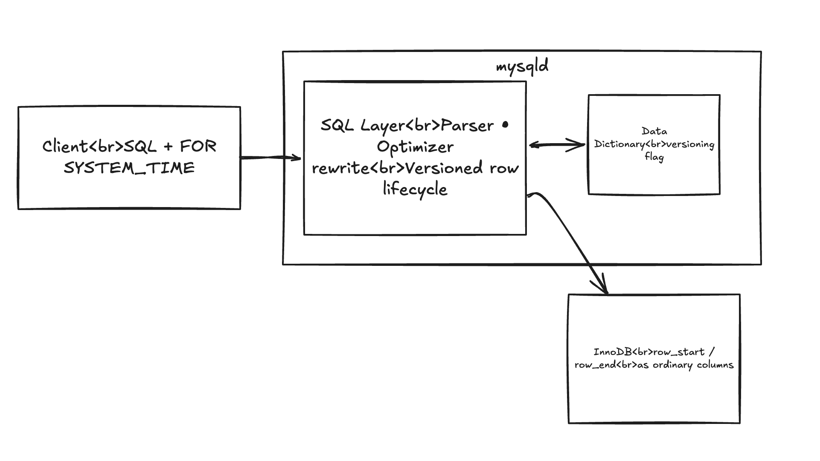
Architecture Overview

Slide 4
Use Case Example
docker run -d --name mariadb-sysver \
-e MARIADB_ROOT_PASSWORD=root \
-p 3399:3306 \
mariadb:11.4
docker exec -it mariadb-sysver mariadb -uroot -proot demo
DROP DATABASE IF EXISTS demo;
CREATE DATABASE demo;
USE demo;
CREATE TABLE accounts (
id INT PRIMARY KEY,
owner VARCHAR(64) NOT NULL,
balance DECIMAL(10,2) NOT NULL
) WITH SYSTEM VERSIONING;

Slide 5
Use Case Example
SET SESSION max_recursive_iterations = 5000;
INSERT INTO accounts (id, owner, balance)
WITH RECURSIVE seq AS (
SELECT 1 AS n
UNION ALL
SELECT n + 1 FROM seq WHERE n < 2000
)
SELECT n, CONCAT('owner_', n), ROUND(RAND() * 10000, 2)
FROM seq;
SELECT COUNT(*) FROM accounts; -- expect 2000
SELECT NOW(6); -- copy this timestamp, you'll use it below

Slide 6
Use Case Example
DELETE FROM accounts;
SELECT COUNT(*) FROM accounts; -- expect 0 (current snapshot)
-- Replace the timestamp with the NOW(6) you captured above:
SELECT COUNT(*)
FROM accounts FOR SYSTEM_TIME AS OF TIMESTAMP'2026-05-26 04:12:42.185677';
-- expect 2000
SELECT COUNT(*) FROM accounts FOR SYSTEM_TIME ALL;
-- expect 2000
SELECT id, owner, balance, row_start, row_end
FROM accounts FOR SYSTEM_TIME ALL
ORDER BY id
LIMIT 5;

Slide 7
Use Case Example
MariaDB [demo]> SELECT COUNT(*) FROM accounts FOR SYSTEM_TIME AS OF TIMESTAMP'2026-05-26 04:17:19.132442';
+----------+
| COUNT(*) |
+----------+
| 2000 |
+----------+
1 row in set (0.002 sec)
MariaDB [demo]> SELECT COUNT(*) FROM accounts;
+----------+
| COUNT(*) |
+----------+
| 0 |
+----------+
1 row in set (0.002 sec)

Slide 8

Thank You!

