Slide 1


Support InnoDB-based binary log (transactional binlog stored within InnoDB)
Vinicius Grippa
Lead Database Engineer @ Readyset

Slide 2
Support InnoDB-based binary log (transactional binlog stored within InnoDB)
https://bugs.mysql.com/bug.php?id=120430
The binary log is currently a separate, file-based log written outside InnoDB's transactional layer. Every durable, replicated commit pays for two fsyncs (sync_binlog=1 + innodb_flush_log_at_trx_commit=1) and a two-phase commit between redo and binlog, plus a non-trivial crash-recovery reconciliation. Storing binlog events inside InnoDB would collapse this into a single durability domain.

Slide 3
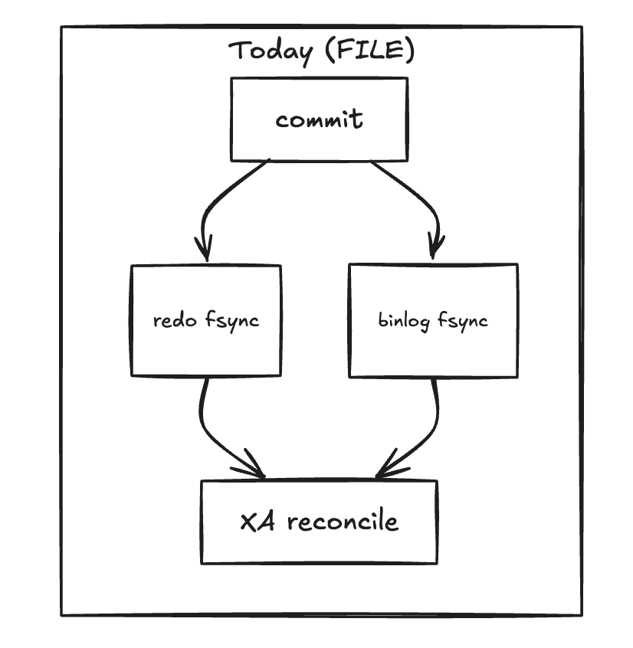
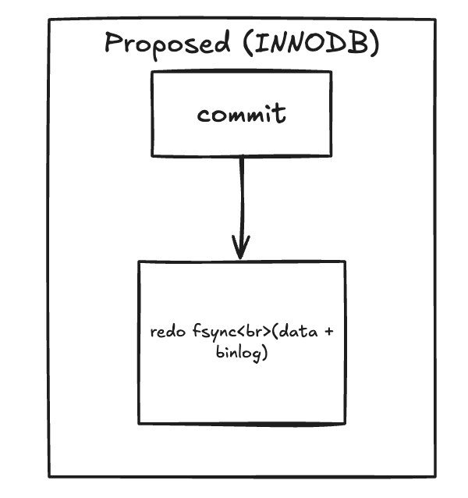
Architecture Overview

Slide 4
Advantages
One fsync per commit instead of two.
  Today, sync_binlog=1 + innodb_flush_log_at_trx_commit=1 costs a redo fsync and a binlog fsync. Merging the binlog event into the redo stream collapses both into one flush.
No XA between binlog and InnoDB.
  The current commit path is prepare InnoDB → write+fsync binlog → commit InnoDB. That ordering exists only to keep binlog and redo consistent on crash. Putting the event into the same mtr makes them atomic by construction, so the prepare/commit handshake disappears.
No binlog cache → file copy on commit.
  Each session today buffers events in binlog_cache_size memory (spilling to a temp file beyond that) and copies them into the binlog file at commit. That memcpy + write hop is gone; events go straight into the mtr buffer that's already being written.
No rotation stalls
  Binlog rotation (max_binlog_size reached, FLUSH BINARY LOGS) currently serializes commits behind a global mutex while the old file is fsynced and a new one is opened.

Slide 5
Disadvantages
Couples binlog durability to InnoDB durability.
  Today sync_binlog and innodb_flush_log_at_trx_commit are independent. You can run "binlog must survive, redo can lose 1s" or the reverse.
Breaks the pluggable-engine model.
  The binlog today is engine-agnostic — MyISAM, MEMORY, future engines all log through it. Putting the binlog inside InnoDB makes InnoDB structurally special.
Ecosystem tooling.
  Debezium, Maxwell, ProxySQL mirror, every "tail mysql-bin.NNNNNN" script, every PITR runbook — all of it assumes file-format binlogs on disk. XtraBackup, MEB, mysqldump --master-data all need rework. The proposal acknowledges this but the ecosystem cost is large.

Slide 6

Thank You!

